Slide 1
Lab 6 Solution hint
by wwy

Slide 2
Lab 6A
At the Southern University of Science and Technology, students receive their grade report at the end of each semester, listing the scores for all their courses.
One day, while studying in the library, Xiaoming and Xiaohong were discussing an interesting and slightly frustrating idea: what if the order in which they planned their revision doesn't align with their actual performance?
They decided to measure this misalignment using a concept called an "inversion pair":
For a list of scores, if there exists a pair of courses i<j, but the score for course i is greater than the score for course j, i.e., a_{i}>a_{j}, then i, j is considered an inversion pair.
Xiaoming wants to count how many inversion pairs are present in his grade list, to evaluate how poorly his study plan matched his results.
- The first line contains an integer n, the number of courses.
- The second line contains n integers, representing the scores of each course in the planned revision order.

Slide 3
Lab 6A sample
7 4 2 5 3
2
Input
5
7 4 2 5 3
Output
7
7 4 2 5 3
3
7 4 2 5 3
1
7 4 2 5 3
1
7 4 2 5 3
0

Slide 4
Lab 6A solution
2 4 7 5 3
7 4 2 5 3
merge-sort
2 4 7 3 5
7 4 2 5 3
4 7 2 5 3
1
1
4 7 2 53
2 4 7 3 5
2 4 7 5 3
2 3 4 5 7
2
2
1

Slide 5
Lab 6A solution
MERGE(A, left, mid, right):
Let L[0..(mid - left)] 和 R[0..(right - mid - 1)]
for i = 0 to (mid - left):
L[i] = A[left + i]
for j = 0 to (right - mid - 1):
R[j] = A[mid + 1 + j]
i = 0 //INDEX OF L
j = 0 // INDEX OF R
k = left // START INDEX OF A
while i < length(L) and j < length(R):
if L[i] ≤ R[j]:{A[k] = L[i];i = i + 1}
else:{A[k] = R[j];j = j + 1;k = k + 1}
while i < length(L):
A[k] = L[i]; i = i + 1;k = k + 1
while j < length(R):
A[k] = R[j]; j = j + 1;k = k + 1
merge-sort
7 4 2 5 3
MERGE-SORT(A, left, right):
if left < right:
mid = floor((left + right) / 2)
MERGE-SORT(A, left, mid)
MERGE-SORT(A, mid + 1, right)
MERGE(A, left, mid, right)
count
add here

Slide 6
Lab 6B
Given a tree where each edge has a weight, and a target path sum k, your task is to find the number of paths in the tree whose total weight equals k. A path is defined as a sequence of nodes connected through edges, and the path sum is the sum of the weights of the edges along that path.
Input Format:
- The first line contains two integers n and k, representing the number of nodes and the target path sum.
- The next n−1 lines each contain three integers u, v, and w, indicating that there is an edge between node u and node v with weight w.
Where:
- 1 ≤ n ≤ 10000: the number of nodes in the tree.
- 0 ≤ k ≤ 1000000: the target path sum.
- 1 ≤ u, v ≤ n: the node indices.
- 1 ≤ w ≤ 10000: the weight of each edge.

Slide 7
Lab 6B sample
4
2
1
3
8
9
5
5
6
7
2
3
3
4
5
2
1
3
1
2
1
3
Sample Input:
5 7
1 2 2
1 3 1
2 4 3
2 5 4
Sample Output:
Yes
2
3
4
2
1
2
3
5
2
1
3
4
4
2
5
4
5
2
1
1
3
4
2
5
2

Slide 8
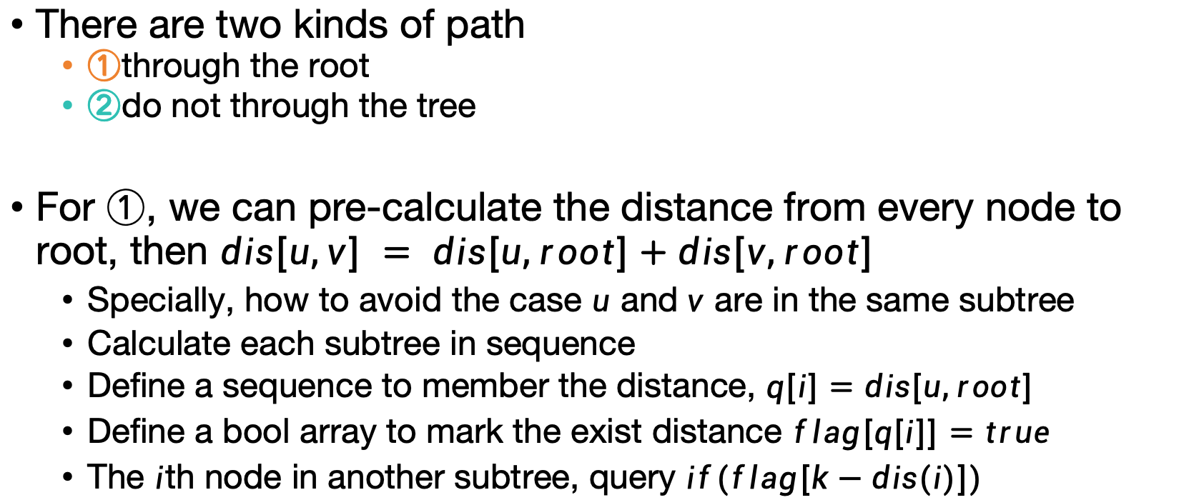
Lab 6B Solution
1
2
5
6
seq
2
3
flag
2
3
There are two kinds of path
①through the root
②do not through the tree
For ①, we can pre-calculate the distance from every node to root, then $dis[u,v] = dis[u,root]+dis[v,root]$
Specially, how to avoid the case $u$ and$v$ are in the same subtree
Calculate each subtree in sequence
Define a sequence to member the distance, $q[i]=dis[u,root]$
Define a bool array to mark the exist distance $flag[q[i]]=true$
The $i$th node in another subtree, query $if(flag[k−dis(i)])$
t
t
t
3
4
... 1 2 3 4 5 6 ...
4
5

Slide 9
Lab 6B Solution
For ②, we can divide the tree until the case become ①
The path 4-2-5 do not through root 1, but through subtree’s root 2
In order to calculate more balance, we need to find the centroid
There whole steps will be
Find the centroid of the tree (get root)
Calculate the distance from every node to root in subtree
Count the path answers of the current tree
Divide every subtree, and do iteration
1
2
3
2
3
3
4
4
5

Slide 10
Lab 6B Solution
calc(u){
for v in every edge(u,v) from u
for n in nodes of subtree root v
dis[]<--get dis(n,u)
for j in dis[]
check path k (flag(k-dis)==true)
for j in dis[]
set flag, flag(dis)=true
put distance into seq
//clear the flag
for i in index of distance seq
flag(seq(i))=false
}
divide(u){
calc(u)//calc dis through u
for t in subtree of u as root
v<--get root of t
divide(v)
}

Slide 11
THX :-)

